Slide 1
Up and Running With
By Fahad Uddin
Advanced Internet Programming
CCNY, Mastars in CS Spring 2017

Slide 2
What is ?
2d Game Framework.
HTML5 and Javascript based.

Slide 3
What is ?
Cross platform game framework.
Fun, free and fast.

Slide 4
What is ?
Official Website
https://phaser.io/
Official Documentation
https://phaser.io/docs/2.6.2/index

Slide 5
Other HTML5 Game Engine.
Babylon.js
Playcanvas
Pixi.js
Melon.js

Slide 6
Other HTML5 Game Engine.
Kiwi.js.
Stage.js.
Crafty.
Panda engine, etc.

Slide 7
Pro’s of ? ?
Cross Platform.
Runs natively on web browser.
Support for Arcade physics, Ninja physics

Slide 8
Pro’s of ? ?
Built in arcade particle system.
Excellent tools for sprite.
Animating is easy.

Slide 9
Pro’s of ? ?
Easy to learn.
Good tutorial sources and books.
Very fast to develop with.

Slide 10
Pro’s of ? ?
Supports Canvas and webgl rendering
Excellent example library.
Great community.

Slide 11
Cons of ? ?
Isn’t hardware accelerated.
Hard to make 3d games.

Slide 12
Cons of ? ?
Poor performance.
If map is not larger then 600*400 px, it is fine.

Slide 13
Requirements for
Basic knowledge of HTML.
Basic knowledge of JavaScript.

Slide 14
Requirements for
Basic knowledge of graphics.
Basic knowledge of sprite sheet.

Slide 15
Downloading
Current version 2.7.3
Released on 9th January 2017

Slide 16
Downloading
Clone | Zip | Js | Tar.gz
https://github.com/photonstorm/phaser
https://phaser.io/download/stable

Slide 17
Editor for
Any editor.
Eclipse, sublime, atom, even notepad.

Slide 18
Image Assets for
Any image genration software.
Flash professional cc
Adobe photoshop etc

Slide 19
Fonts for
System and bitmap.
Littera or Angelcode etc.

Slide 20
Sound effects for
Chiptone
Freesound etc.

Slide 21
Sprite sheet
Better animation.
Easy to use.
https://msdn.microsoft.com/en-us/library/bb203919.aspx
https://docs.unity3d.com/Manual/Sprites.html

Slide 22
Simple Example
Everything is ready?
Let’s see a simple example

Slide 23
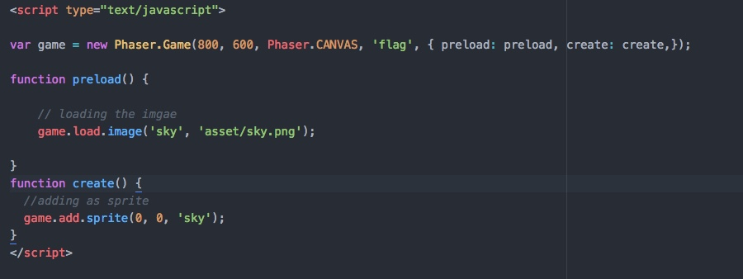
Simple Example
How to add an image

Slide 24

Simple Example
Result

Slide 25
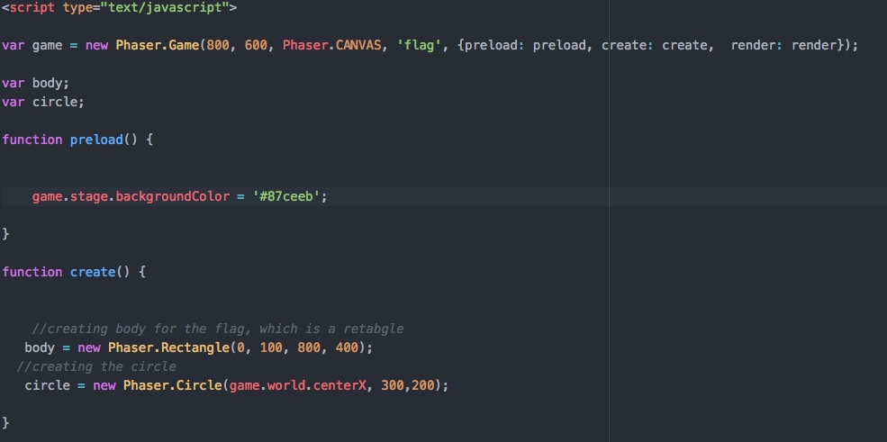
Simple Example

Slide 26
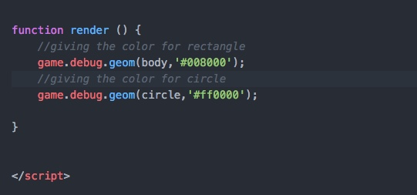
Simple Example

Slide 27

Simple Example
Output

Slide 28
Reference
https://phaser.io/
https://phaser.io/docs/2.6.2/index
Phaser Tutorial – Lynda.com
https://phaser.io/examples

Slide 29
End of our
presentation.
Thank you!

